Slide 1
FMU Research presentation
October 13, 2023
Undergraduate: Kai Adams
Working under: Shane Kosieradzki

Slide 2
Current goals:
Efficiently create and export Functional Mockup Units (FMU)
Programmatically simulate the FMU and graph the results
Utilize custom inputs to impact the outputs
Better understand the exporting and control of FMU based on the standards
Use FMPy as a Functional Mockup Interface (FMI) to accomplish our goals
Future work: upload FMU to microcontroller and use the simulated ‘digital twin’ to predict motion.

Slide 3
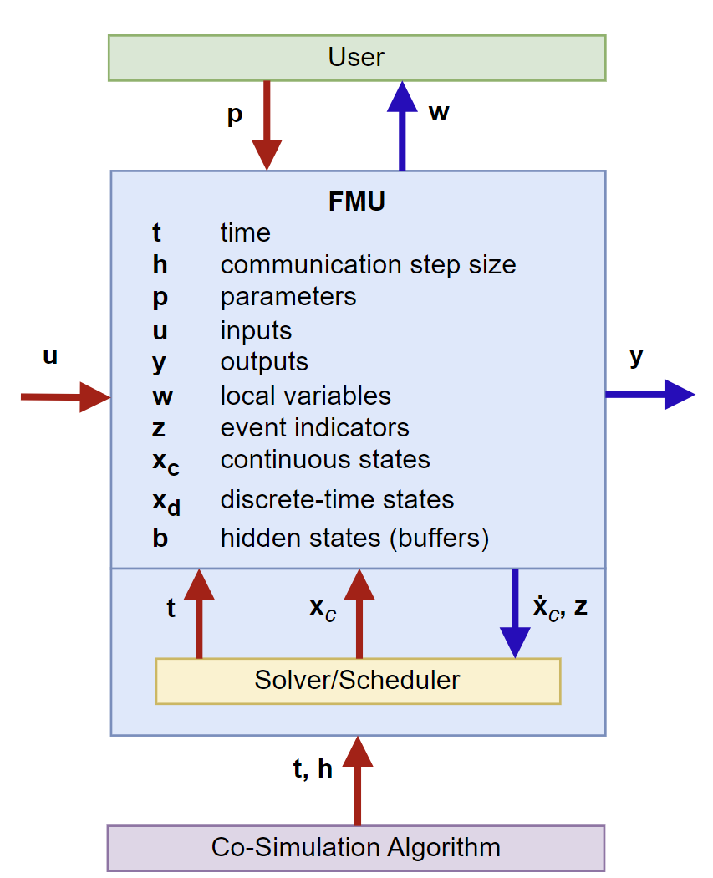
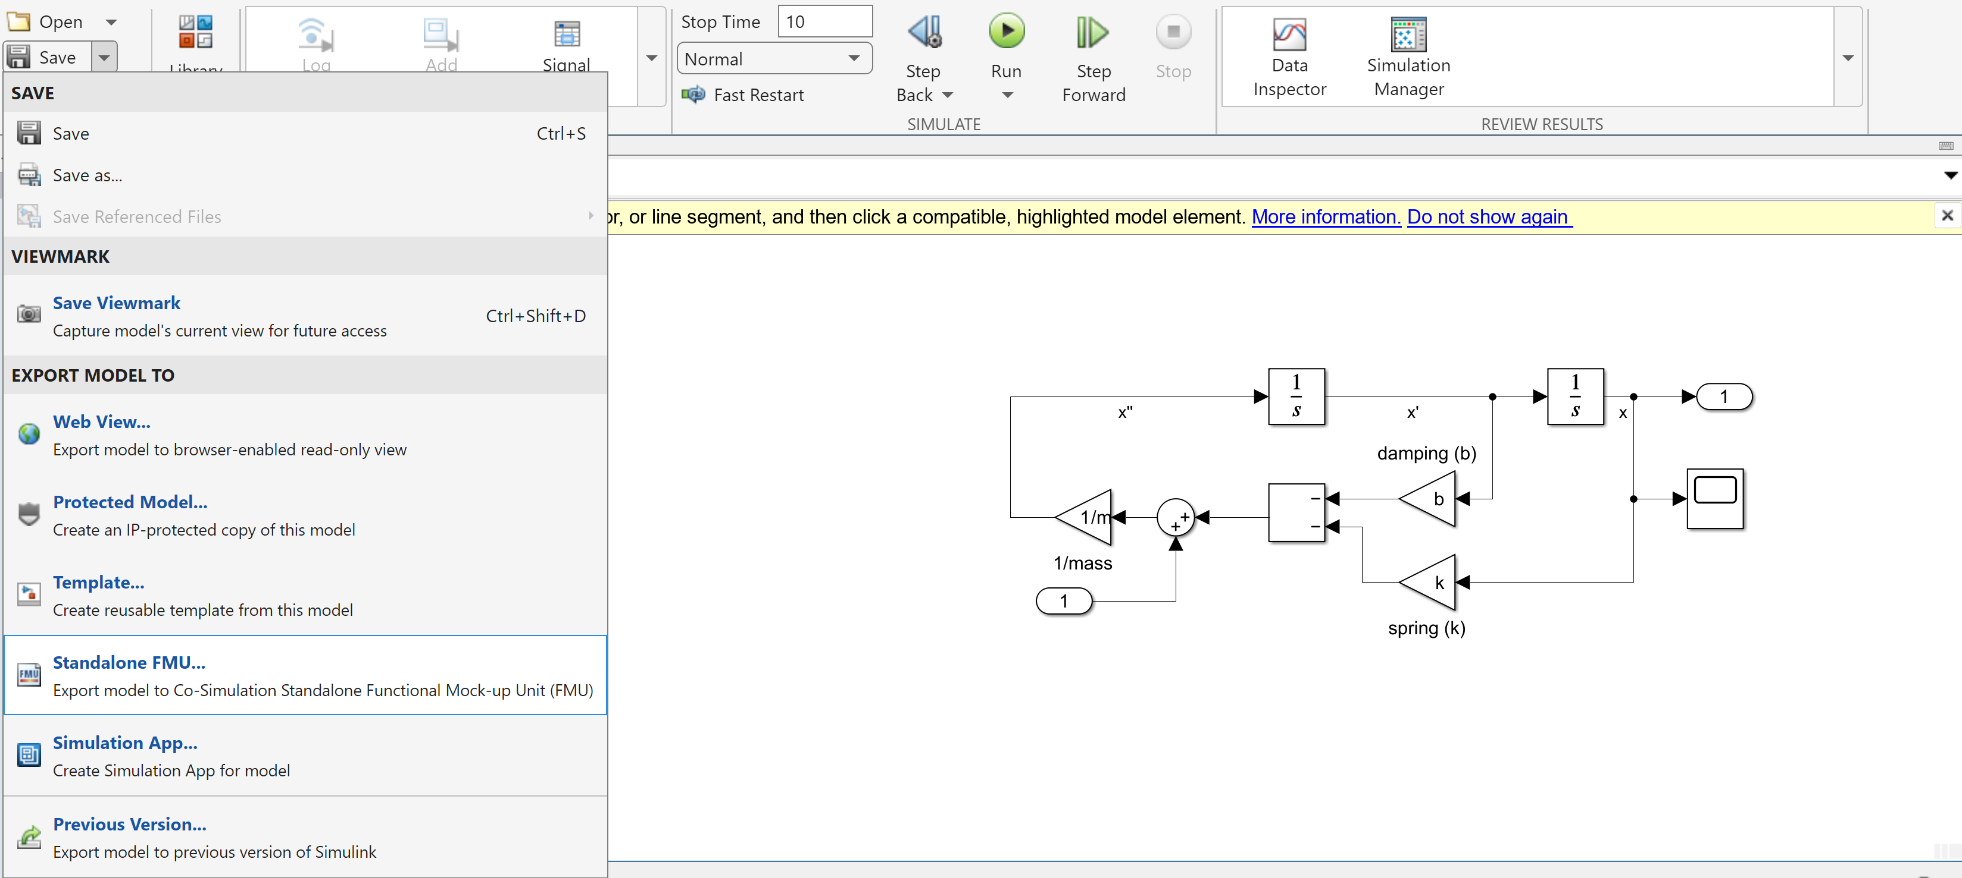
What are FMU?
Functional Mockup Unit is an open-source standard for a compilation of data representing a function/model and included dependencies.
The generated .fmu are essentially standardized .zip files, which we can rename them as such to open them
Currently, we are using these to model simple physical systems, like a mass-spring-damper system
We are using Simulink, a ‘high-level’ tool, to create and export these models
This image is from the Functional Mockup Interface (FMI) documentation and shows how a cosimulation FMU is simulated
How we export our model from Simulink as an FMU file
Simulink Interface with our model

Slide 4
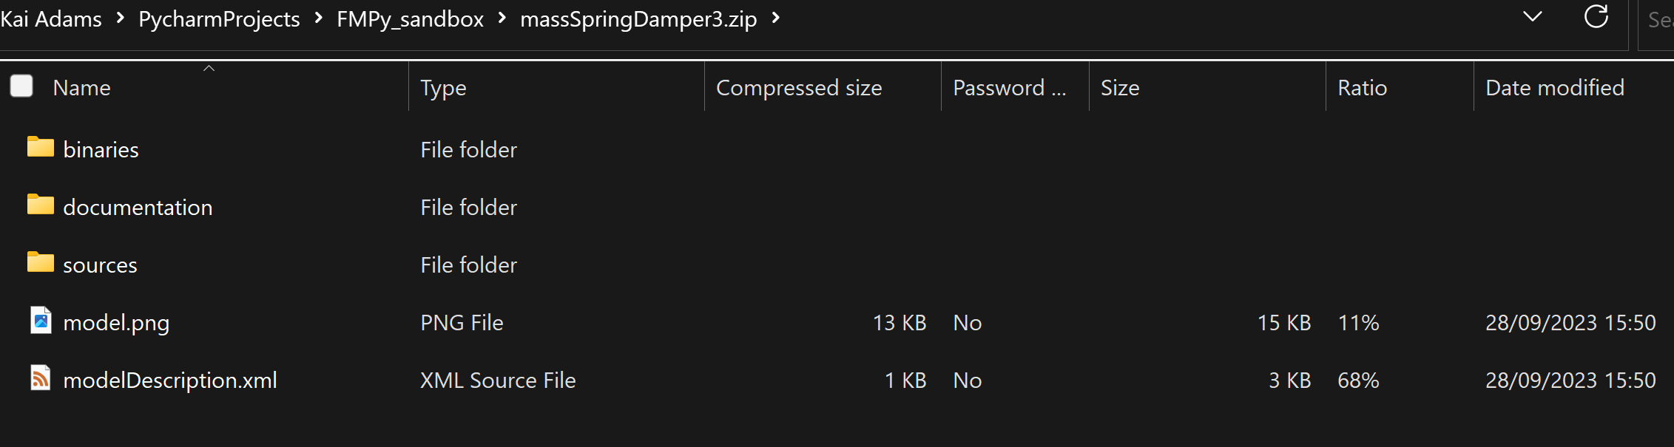
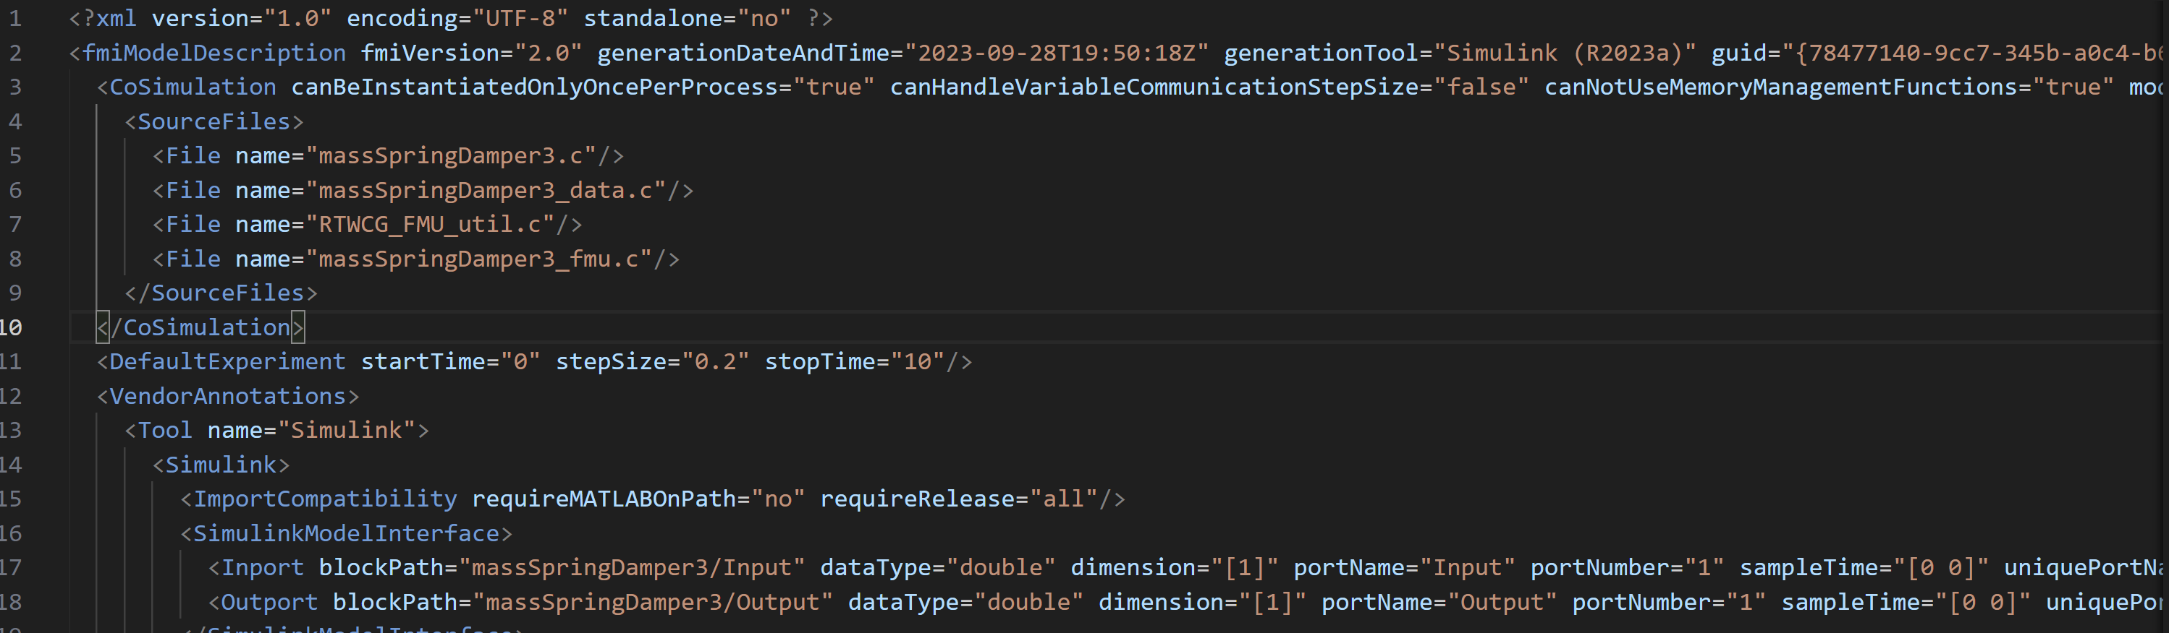
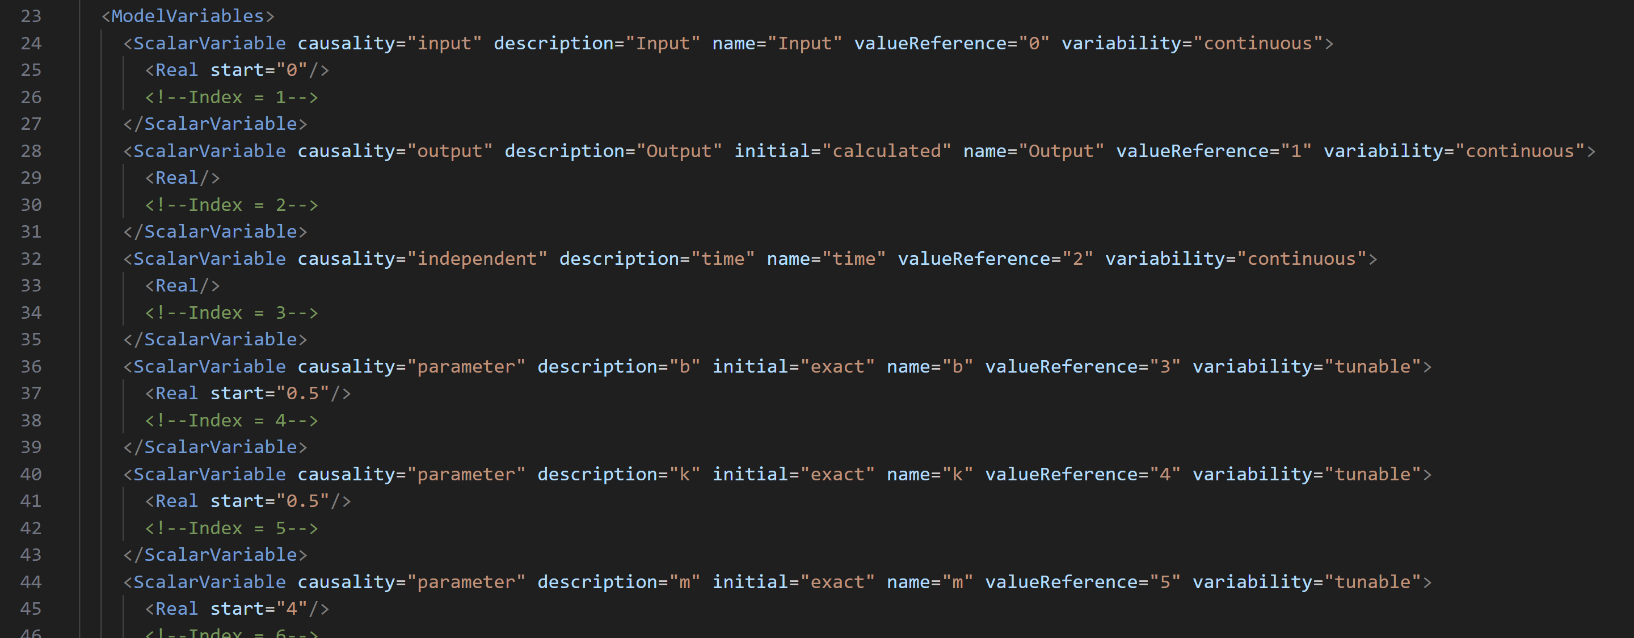
What’s inside an exported FMU?
The ‘sources’ folder includes all of the associated .c and .h files generated to represent the system
Within the .xml file:
Generation data
Experiment start/stop time and time step
Input/output port details
Variable information and parameters
Relative variable indices

Slide 5
Why use FMU?
MATLAB, and by extension Simulink, is not open source. The files created use proprietary methods which we can not examine or change
FMU, on the other hand, is an open-source standard for how to store this data, and thus is much easier to examine and use for custom input and data
Exporting as FMU ensures that the data within fits the open standard, which is much more versatile/compatible than a model simulated on MATLAB or other paid software

Slide 6
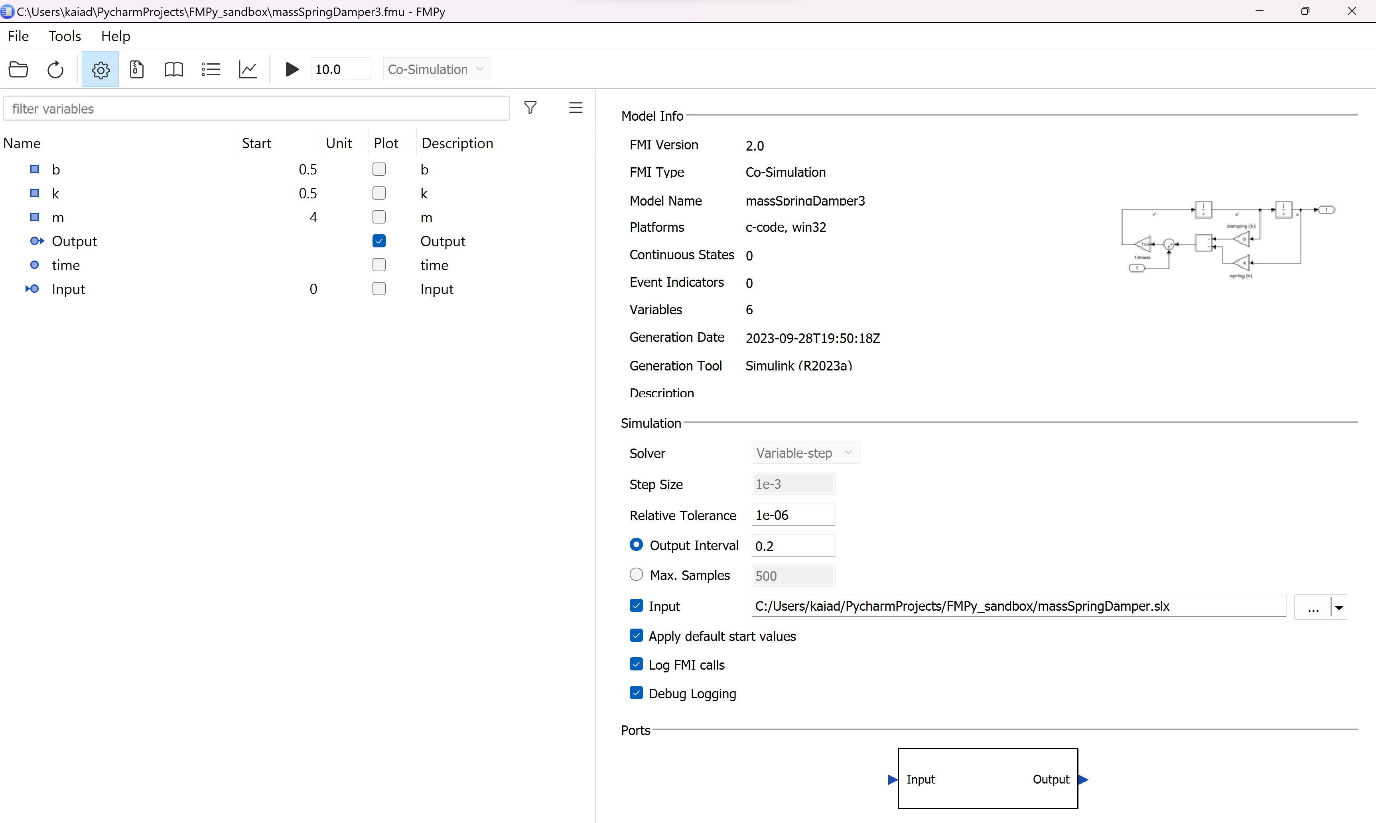
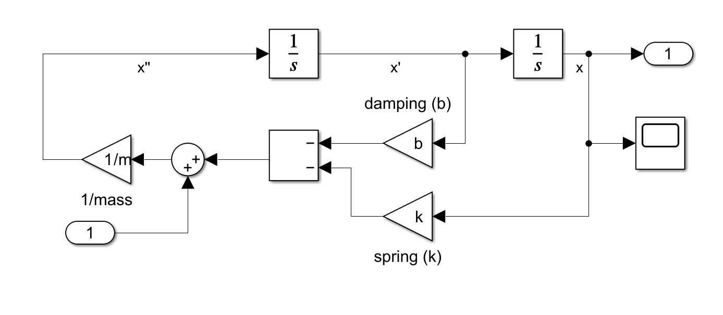
Current approach:
We are currently using FMPy, a python library for interpreting and simulating FMU
From FMPy, we have been able to activate a GUI, which makes editing and simulation easier
To create and export models for simulation/testing, we are using Simulink
Output [Position x in m]
Input [Force in N]
mx’’+bx’+kx = F(t)
The FMPy GUI with our M-S-D model loaded in

Slide 7
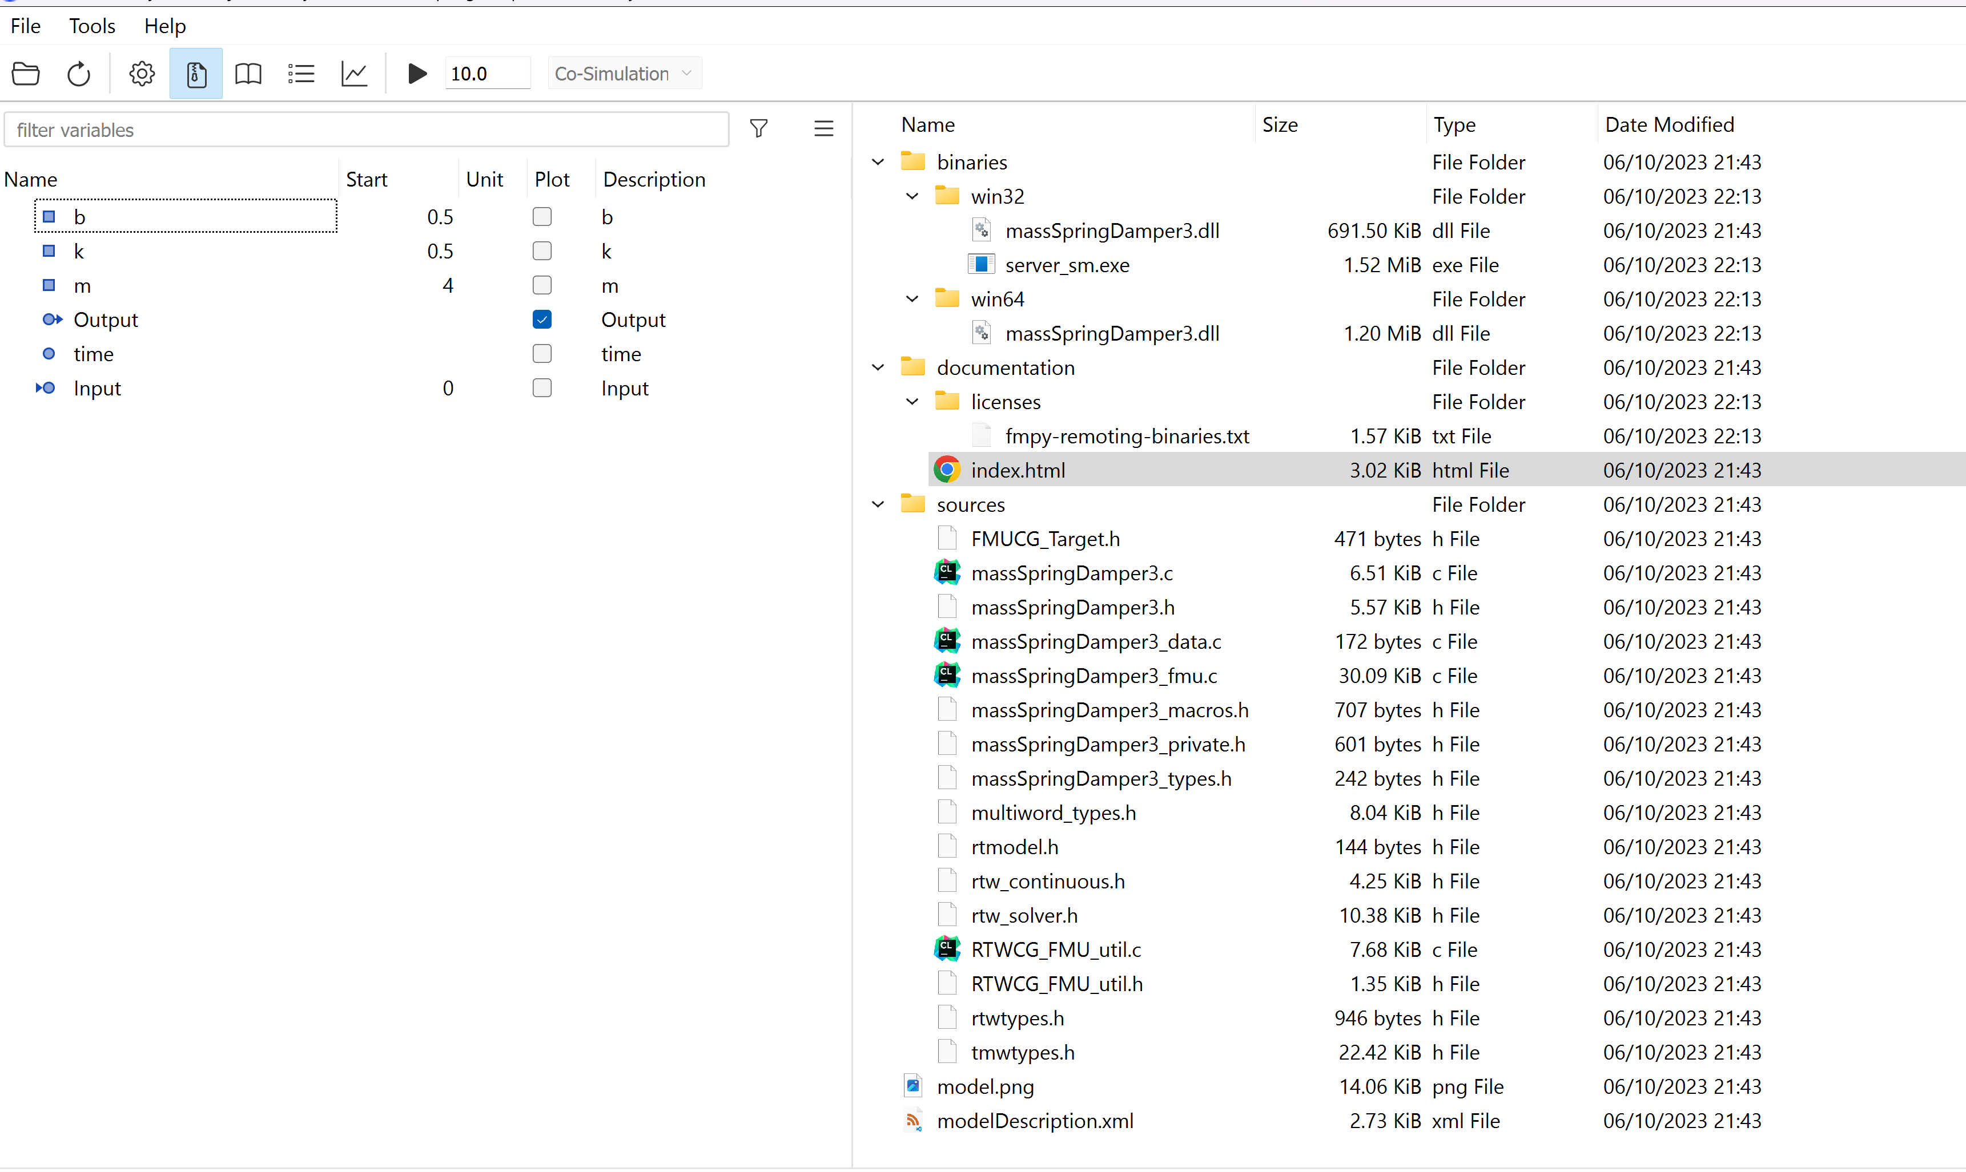
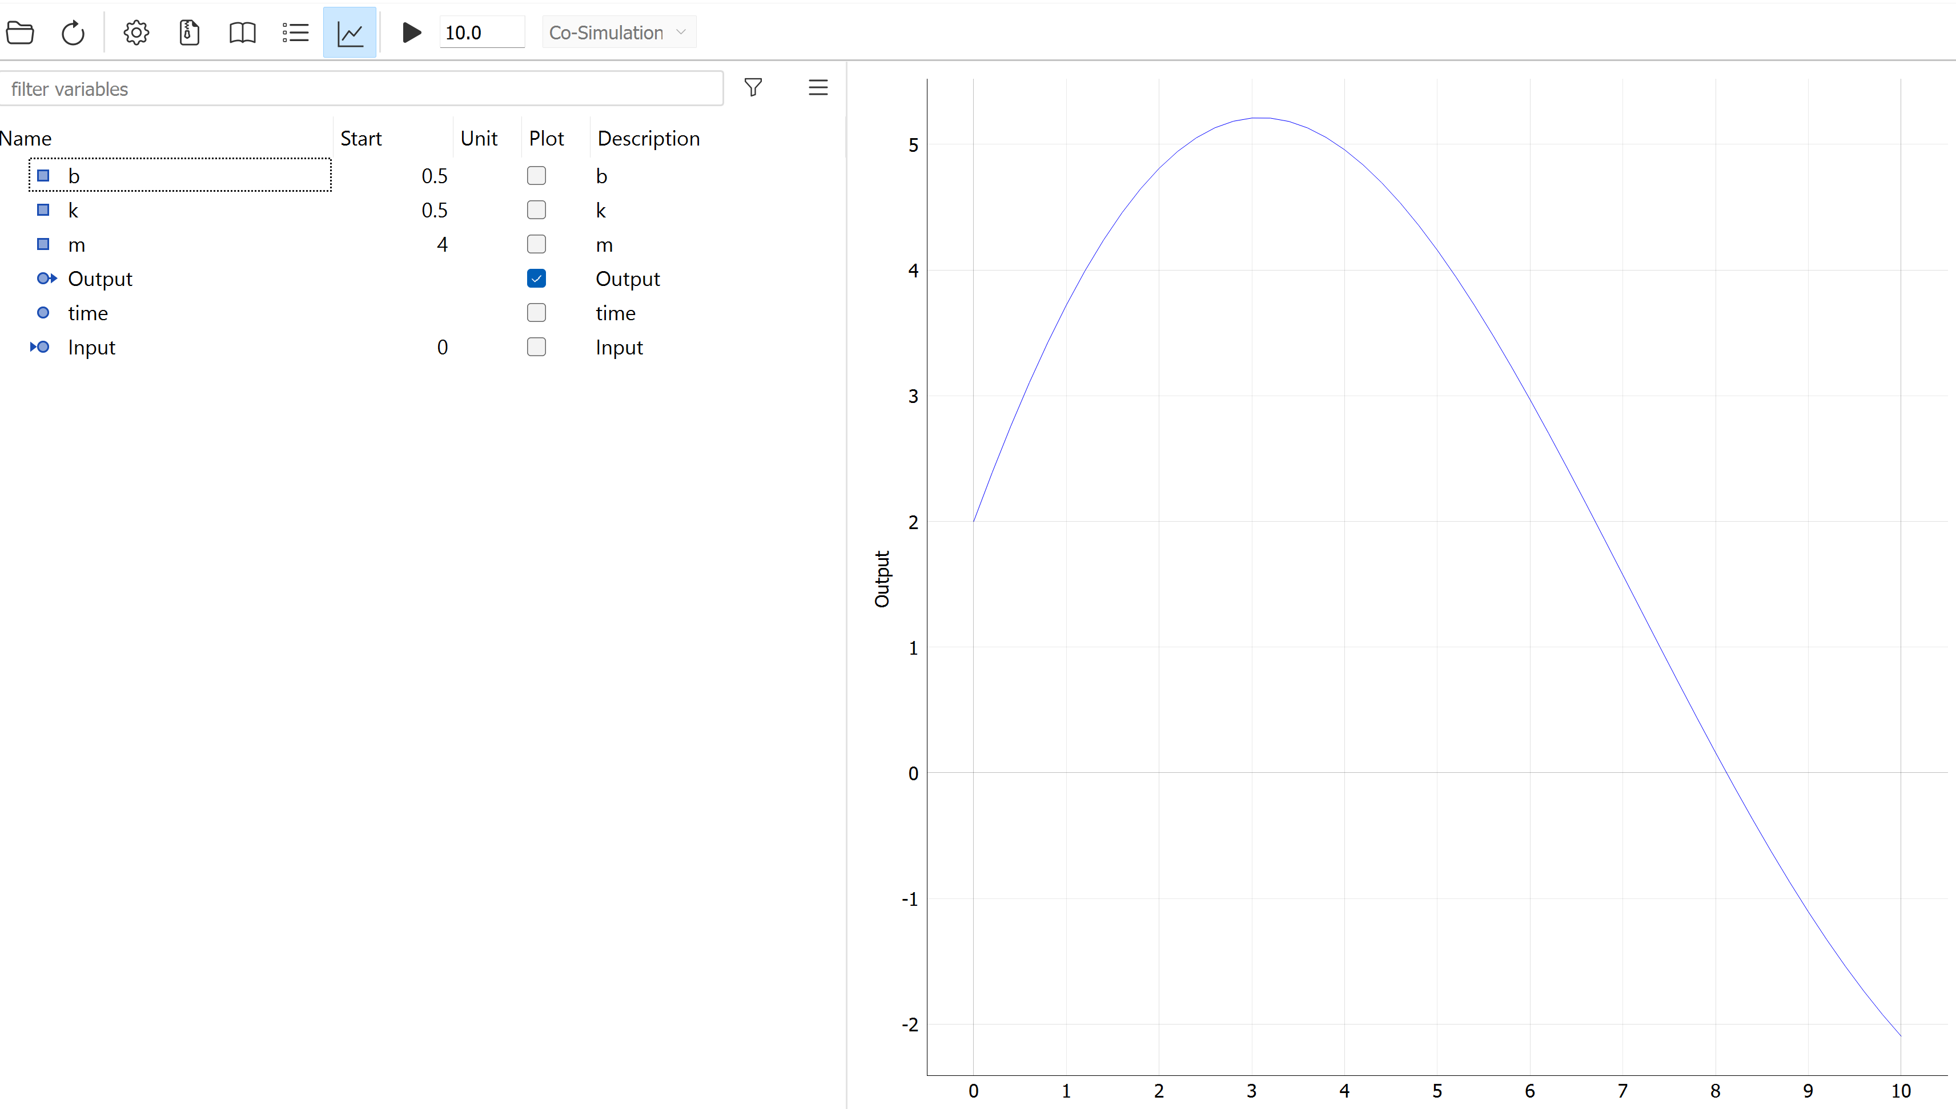
Tools within the FMPy GUI
Validate FMU – checks that dependencies and data within FMU is valid
Create Cmake Project – generates the FMU as a Cmake project. This allows us to export our FMU as a universally usable C code
The zip folder icon allows the contents of the fmu to be viewed as if it was a .zip folder
The graph icon allows the results of the simulation to be shown as a plot after it is run

Slide 8
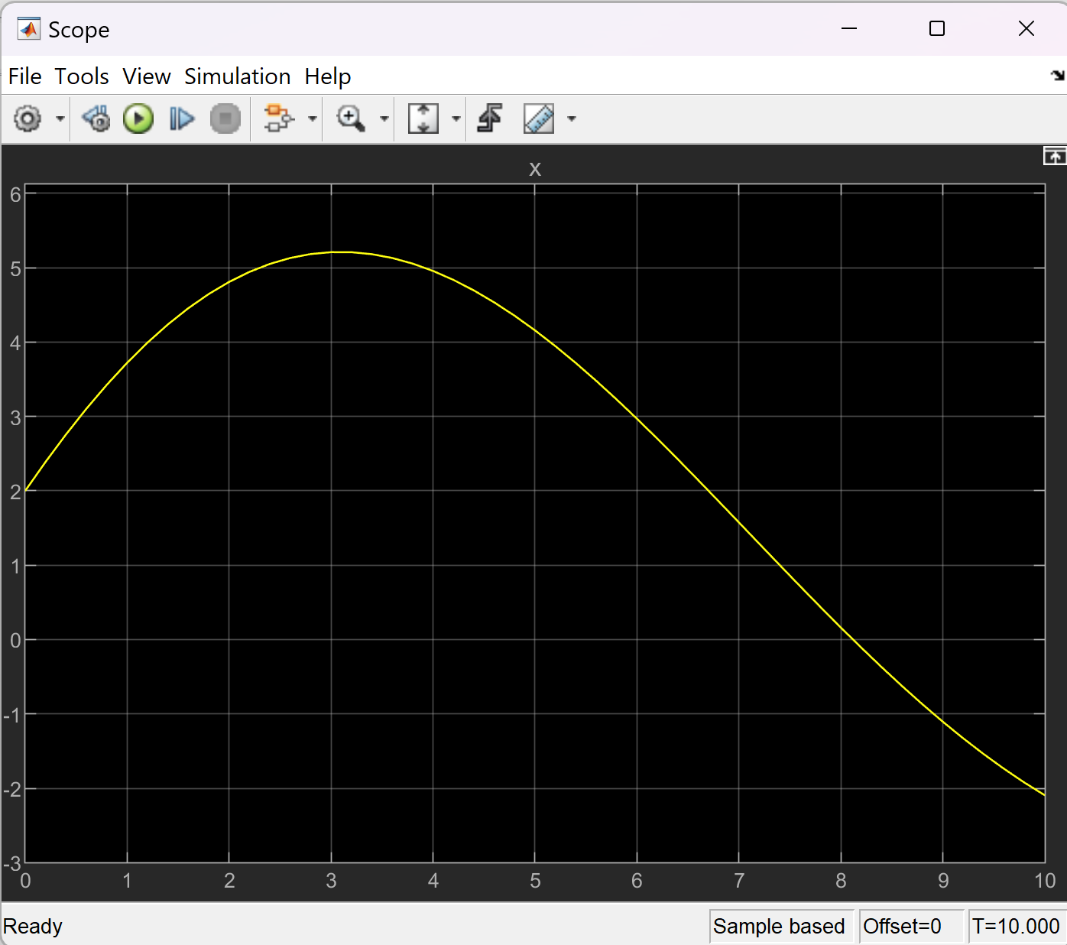
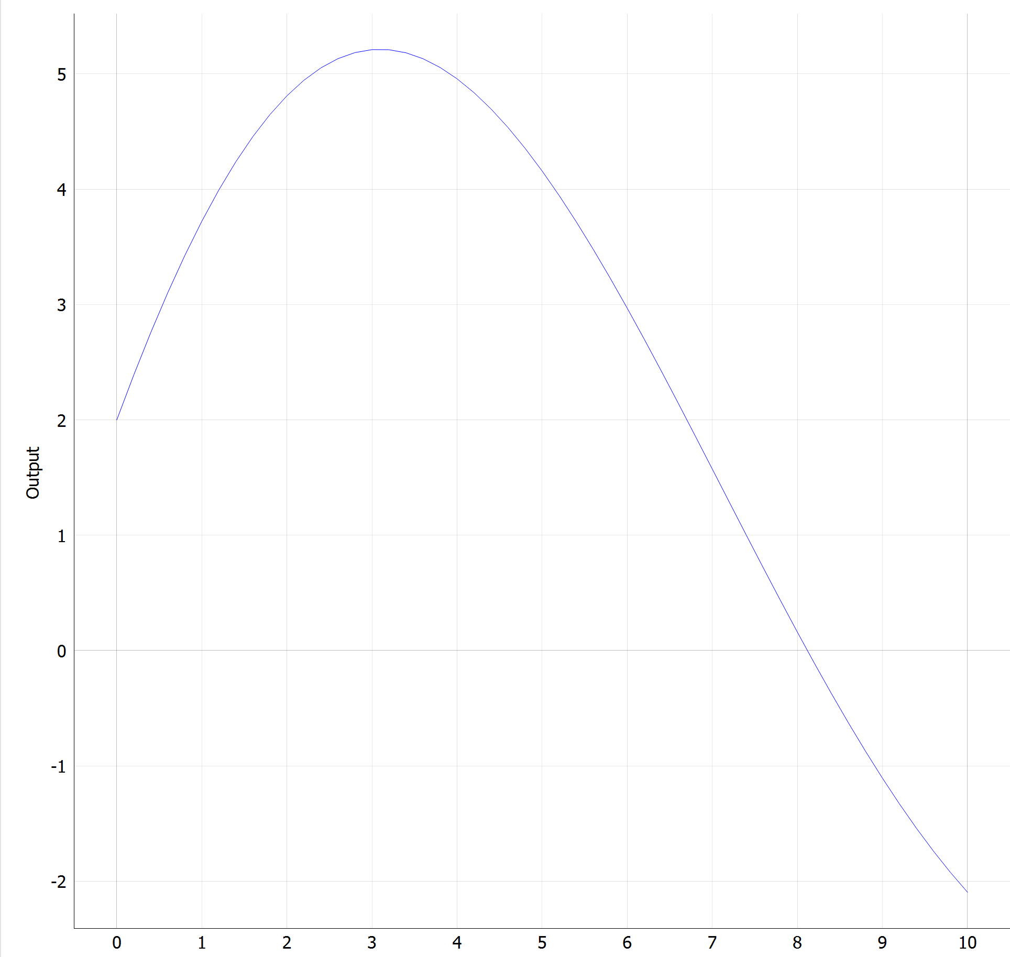
Simulation results from FMPy (left) vs Simulink (right)

Slide 9
Challenges faced:
Originally, the model that was exported as an FMU did not have all of the required factors/dependencies. This was solved by tweaking the internal settings for exporting
The GUI would not start. This was solved through the reinstallation of the required packages.
Currently, there is difficulty utilizing the custom input feature. Connecting a custom input signal to the model is proving to be a challenge.

Slide 10
Questions?

